Slide 1



POTENTIAL OFFICE SPACE OPTIONS
Submitted on – 25/06/2026

Slide 2






City Snapshot
OVERVIEW
ECONOMY
14 Mn Population
(Annual growth of ~3.5% since 2015)
Largest IT Exports (47%)
1st in Ease of Living Index in India
10% contribution to GDP
Most Millennial friendly city in India, 18th in the World
Largest Tech Base in Asia
4th largest in the world
Worlds Fastest Growing Tech Hub
IT ECOSYSTEM
TALENT POOL
4000+ IT Companies,
Largest Software Hub in India
~200,000+ graduates per annum
Presence of Over 400+ R&D Centers & 850+ GICs
~ 300+ Engineering Colleges
43 unicorns : Largest hub in the Country
Startup capital of India
52% Migratory Population

Slide 3


Conventional RE Snapshot
Micromarket | Stock (Mn Sft) | Vacancy (Mn Sft (%) | Rental Range (INR /Sft/Month)
Central Business District | 12.3 | 0.85 (6.9%) | 90 – 250
Secondary Business District City | 34.3 | 5.07 (14.8%) | 75 – 175
Outer Ring Road | 96.7 | 13.5 (14%) | 75 – 120
Whitefield & Brookefield | 52.4 | 11.6 (22.1%) | 58 – 85
North Bengaluru | 13.6 | 5.1 (37.4%) | 50 – 85
South Bengaluru | 14.4 | 1.9 (13.2%) | 48 – 75
Doddaballapur Rd
Towards Hyderabad NH44
Bengaluru International Airport
Stock
224 Mn Sft
Tumkur Rd
NORTH BENGALURU
Old Madras Rd
SBD CITY
ORR Z3
Magadi Rd
CBD
Vacancy
17%
ORR Z2
WHITEFIELD & BROOKEFIELD
Old Airport Rd
ORR Z1
PBD WEST
Mysore Rd
SOUTH BENGALURU
Sarjapura Road
Kanakapura Rd
Hosur Rd
Estimated Supply 2024
13.2 Mn Sft
Key Takeaways :
East Bengaluru (ORR & Whitefield dominate more than 50% of the stock in Bengaluru
Vacancy is highest in Whitefield & Brookefield
Average Rental
95 INR /Sft/Month

Slide 4
Flex RE Snapshot
Micromarket | Stock (Mn Sft) | Vacancy (Mn Sft (%) | No of Centers | Rental Range (INR /Sft/Month)
Central Business District | 41,854 | 8,937 (10%) | 69 | 7,000 – 38,000
Secondary Business District City | 1,12,787 | 35,589 (32%) | 189 | 5,000 – 35,000
Outer Ring Road | 1,12,776 | 28,504 (25%) | 63 | 7,500 – 25,000
Whitefield & Brookefield | 25,817 | 6,804 (26%) | 27 | 6,500 – 25,000
North Bengaluru | 4,134 | 962 (23%) | 10 | 6,000 – 20,000
South Bengaluru | 17,804 | 5,478 (31%) | 11 | 6,500 – 12,000
Doddaballapur Rd
Towards Hyderabad NH44
Bengaluru International Airport
Stock
3,43,516 Seats
Tumkur Rd
NORTH BENGALURU
Old Madras Rd
SBD CITY
ORR Z3
Magadi Rd
CBD
Vacancy
89,738 Seats
(26.1%)
ORR Z2
WHITEFIELD & BROOKEFIELD
Old Airport Rd
ORR Z1
PBD WEST
Mysore Rd
SOUTH BENGALURU
Sarjapura Road
Kanakapura Rd
Hosur Rd
Number of Centers
427
Key Takeaways :
More MNCs are opting for Enterprise Solution
Flex space take up has risen by 30% over past 5 years
Average Rental
5,000 - 38,000
INR /Seat/Month

Slide 5
Future Supply
224 Mn Sft
Current Stock
13.2 Mn Sft
Estimated Supply (2024)
15.4 Mn Sft
Future Supply (2025)
Supply 2023 vs Future Supply 2024 : Micromarket Split
KEY TAKEAWAYS :
Projected Supply : East Bengaluru & North Bengaluru are expected to have the maximum influx of supply
Metro line will be connecting the entire city by 2028

Slide 6



Metro Connectivity
Doddaballapur Rd
Towards Hyderabad NH44
Bengaluru International Airport
City Connectivity : All Key Markets to be connected by Metro & Suburban railway by 2027*
NORTH
METRO – PHASE I (OPERATIONAL) | 73.81 Kms (70 stations)
Bellary Road
NORTH BENGALURU
Corridor 1
Challaghatta – Whitefield
Passing through CBD & SBD City, connecting West Bangalore to East Bengaluru
Phase II Extension : Baiyyappanahalli – Whitefield connecting SBD City to Whitefield
Yelahanka
Yeswanthpur
ORR Z3
Old Madras Rd
SBD CITY
(SEPT 2027)
K.R Puram
Corridor 2
Nagasandra – Silk Institute
Passing through CBD & SBD City and connecting North West Bengaluru to South West Bengaluru
Phase II Extension : Hesaraghatta Cross – Madavar connecting SBD City to North West Bengaluru
WEST
Bengaluru City Railway Station
ORR Z2
WHITEFIELD & BROOKEFIELD
CBD
EAST
ORR Z1
Old Airport Road
METRO – PHASE II (UNDER CONSTRUCTION) | 101.73 Kms (67 stations)
Old Airport Rd
Bidadi
Kengeri
Bellandur
PBD WEST
Corridor 3
Phase 2A: Central Silk Board – KR Puram
Phase 2B: KR Puram – Hebbal – Airport
Passing through ORR and North Bengaluru (Sept 2027)
SOUTH BENGALURU
Sarjapur Road
(MAR 2026)
(JUN 2026)
Heelalige
Corridor 4
Gottigere – Nagawara
Hosur Road
Passing through CBD, SBD City & ORR (March 2026)
Bannerghatta Road
Hosur Rd
METRO WEBSITE LINK
SOUTH
Corridor 5
R. V Road – Bommasandra
Metro
(Operational)
Green Line
Purple Line
Passing through South Bengaluru (June 2026)
(Upcoming)*
Pink Line
Blue Line
Yellow Line
(MAR 2025)
(SEP 2027)
(JUN 2025)
Suburban Railway Lanes
(PROPOSED)

Slide 7


Road Connectivity
KEY ROADS :
Doddaballapur
Devanahalli
Doddaballapur Rd
Bengaluru International Airport
8 Major Roads in Bangalore : Old Madras Road, Old Airport Road, Sarjapura Rd, Hosur Rd, Kanakpura Rd, Mysore Rd, Magadi Rd, Tumkur Rd & Doddaballapur Rd
NH44 : Connects Bangalore to Hyderabad
NH 75 : Connects to Chennai
NH 7 : Connects to Salem
Tumkur Road : Connects to Pune & Mumbai
Peripheral Ring Road : 73 kms (Under Construction)
Satellite Town Ring Road : 280.8 kms (Under Construction)
Connecting key highways at Key satellite Towns
NICE : Nandi Infrastructure Corridor Enterprises Road : 9 kms
Initially intended to connect Bangalore to Mysore
Towards Hyderabad NH44 (NH7)
Satellite Town Ring Road (STRR)
Dobbespet
Hoskote
Tumkur Rd
NORTH BENGALURU
Old Madras Rd
Chennai NH 75 (NH4)
SBD CITY
ORR Z3
Magadi Rd
CBD
ORR Z2
WHITEFIELD & BROOKEFIELD
Old Airport Rd
Magadi
ORR Z1
PBD WEST
Mysore Rd
SOUTH BENGALURU
Sarjapura Road
Hosur Rd
Towards Salem (NH7)
Ramnagara
Kanakapura Rd (NH 209)
Anekal
Kanakpura

Slide 8
PROPOSED OPTIONS

Slide 9
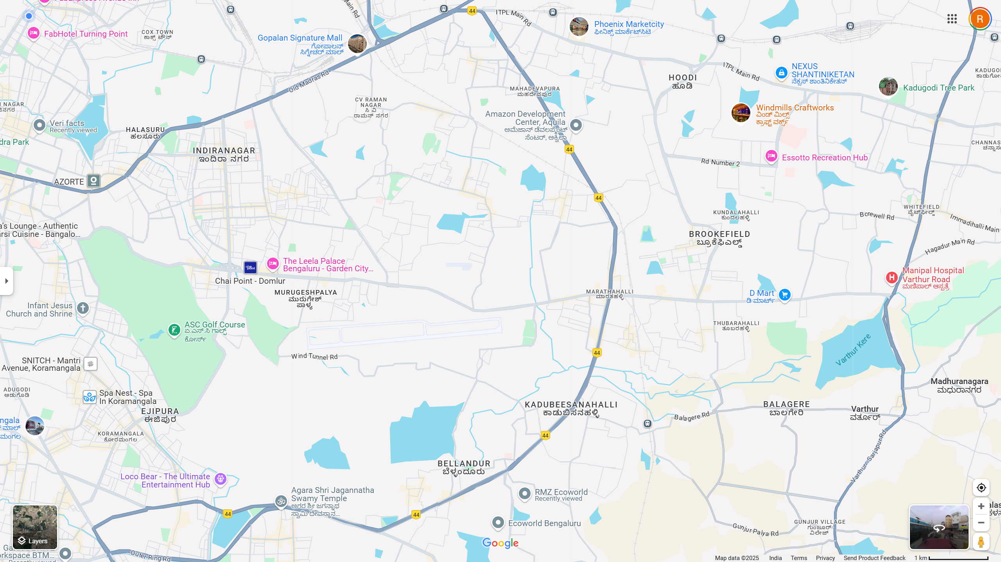
LOCATION MAP – INDICATING PROPOSED OPTIONS
15
16
SL.NO | PROPERTY NAME | LOCATION
1 | SATTVA AURA | Outer Ring Road
2 | Prestige Technology Park | Outer Ring Road
3 | Umiya Business Bay | Bellandur
4 | Zonasha IT | Mahadevapur ORR
5 | Bagmane Constellation | Mahadevapur ORR
6 | Helios Tech Park | Outer Ring Road
7 | Prestige Tech Pacific | Bellandur
8 | DivyaSree Town Centre | Yemalur
9 | Prestige Tech Park IV | Outer Ring Road
10 | RMZ Ecoworld | Outer Ring Road
11 | RMZ Ecospace | Outer Ring Road
12 | Mantri Commerce | Outer Ring Road
13 | Global Tech Park | Outer Ring Road
14 | Vaishnavi Tech Park | Sarjapur Road
15 | Manyata Tech Park | Nagawara
16 | BCIT | North Bangalore
5
4
8
9
2
7
1
3
6
12
13
10
11
14

Slide 10
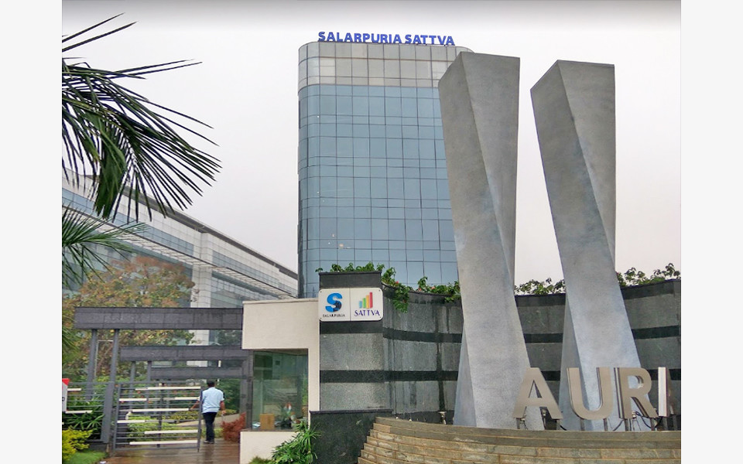

Option – 1 – Sattva Aura
Name of the Developer | Sattva Group
Block/ Tower offered | Grade A Building
Location | ORR
COMMERCIAL DETAILS
Quoted Rental [INR/ Sq. Ft./ Month] | INR 115 (As is where is basis)
Common Area Maintenance Charges [INR/ Sq. Ft./ Month] | INR 15.00
Car Parking Charges [INR/ Slot/ Month] | INR 3000
Rental Escalation [% In Months] | 6% every 12 months
Interest Free Refundable Security Deposit [In Months] | 12
Lease Term [In Months] | 60
Lock-In Period [In Months] | 36
Notice Period for Termination [In Months] | 3
PROPOSED SPACE/ BUILDING DETAILS
Total No. of Floors | Basement + Ground + 6 Upper Floors
Average Floor Plate Size [In Sq. Ft.] | 44,000
Floor Plate Efficiency [Approx.] | 80% (+/-2%)
DETAILS OF THE SPACE OFFERED
Area Offered [In Sq. Ft.] | 38440 and 41412
Floor Offered | Ground floor and first floor
Condition of Space | Furnished
Power [In kVA] | 1 kVA/ 100 Sq.ft
Power Back-up | 100%
Car Parking Ratio | 1 Slot/ 1000 Sq.Ft.
Timeline | Immediate
Building Has all approvals like OC, Sanction plan etc.
Nearest bus stop 200 Mtrs
Nearest Metro station 300 Mtrs (Under construction)
Close by eateries available
Distance from Silk Board 8 KMS
Distance from Central 17 KMS
Distance from BIAL 42 KMS

Slide 11
Why Bangaloreoffice?
DIFFERENTIATOR
EHS Due Diligence/Survey - Expertise in conducting a thorough Environmental Health and Safety audit/survey of every shortlisted property much before going forward for a negotiation. Social and Support Infrastructure reviews. These are critical aspects to be completed, even before coming to a conclusion of the shortlisted options/properties.
Government Departmental Relationship - We have an excellent working relationship with all government departments, which helps in scanning/ascertaining the timelines of the occupancy certificate, reliability of electricity power, fluctuation on the taxation, stamp duty charges etc.
Technical Review - Complete technical survey of the building such as glazing, direction of the sun light, chiller types, floor loading, car park size measurements, Diesel generator make, Facility management firms capability etc.
Market Intelligence - Market analysis including micro market location trends and competition benchmarking.
First Cut Legal Review - Sanction plans, Occupation certificate, Fire clearance, Draft LOI/Lease Deed.

Slide 12
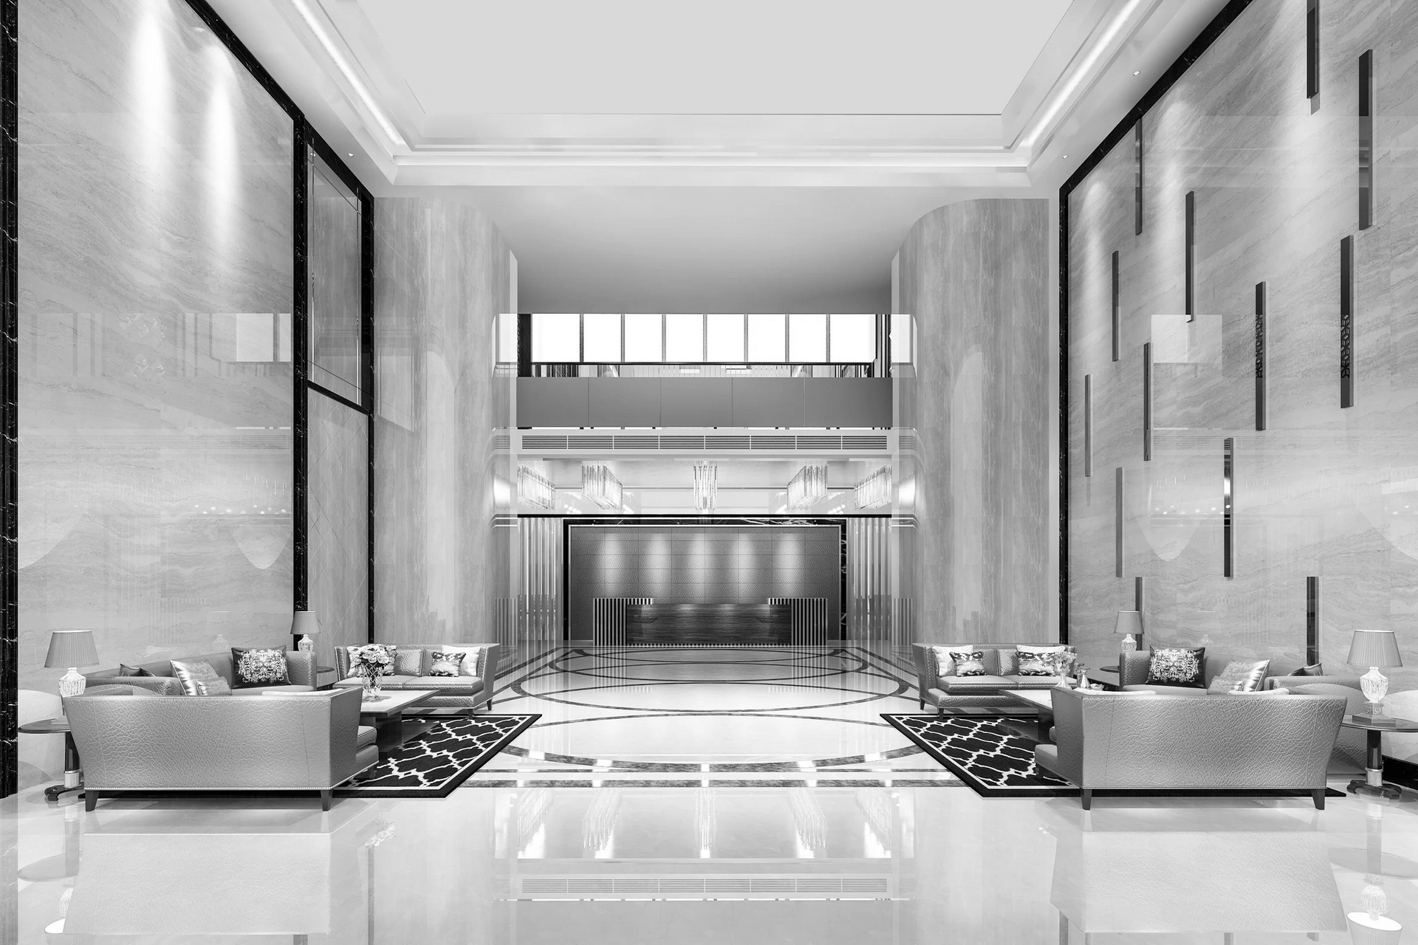
Connect with us.
For more details and site visits contact Us
Raghavendra R Mohammed Tasleel T: +91 9900490090 T: +91 9900102034 raghavendra@bangaloreoffice.com tas@bangaloreoffice.com

Slide 13
THANK YOU
We provide the service you need!

